Slide 1
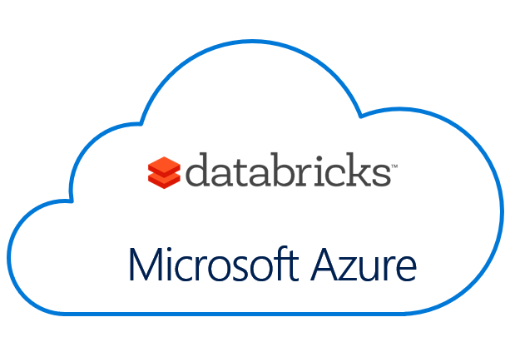
Azure Databricks SQL Deep Dive Bryan Cafferky Data Solutions Enabler
https://github.com/bcafferky/shared

Slide 2




Azure
Easy
Cluster Creation
Scheduling
Big Data
Databricks IDE
Notebooks
Security
Collaboration

Slide 3
Apache Spark
An unified, open source, parallel, data processing framework for Big Data Analytics
Spark SQL
Interactive Queries
Spark MLlib
Machine Learning
Spark Streaming
Stream processing
GraphX
Graph Computation
Spark Unifies:
Batch Processing
Interactive SQL
Real-time processing
Machine Learning
Deep Learning
Graph Processing
Spark Core Engine
Yarn
Mesos
Standalone Scheduler
Spark MLlib
Machine Learning
Spark Structured Streaming
Stream processing

Slide 4
General Spark Cluster Architecture
Driver Program SparkContext
‘Driver’ runs the user’s ‘main’ function and executes the various parallel operations on the worker nodes.
The results of the operations are collected by the driver
The worker nodes read and write data from/to Data Sources including HDFS.
Worker node also cache transformed data in memory as RDDs (Resilient Data Sets).
Worker nodes and the Driver Node execute as VMs in public clouds (AWS, Google and Azure).
Cluster Manager
Worker Node
Worker Node
Worker Node
Cache
Cache
Cache
Task
Task
Task
Data Sources (HDFS, SQL, NoSQL, …)

Slide 5
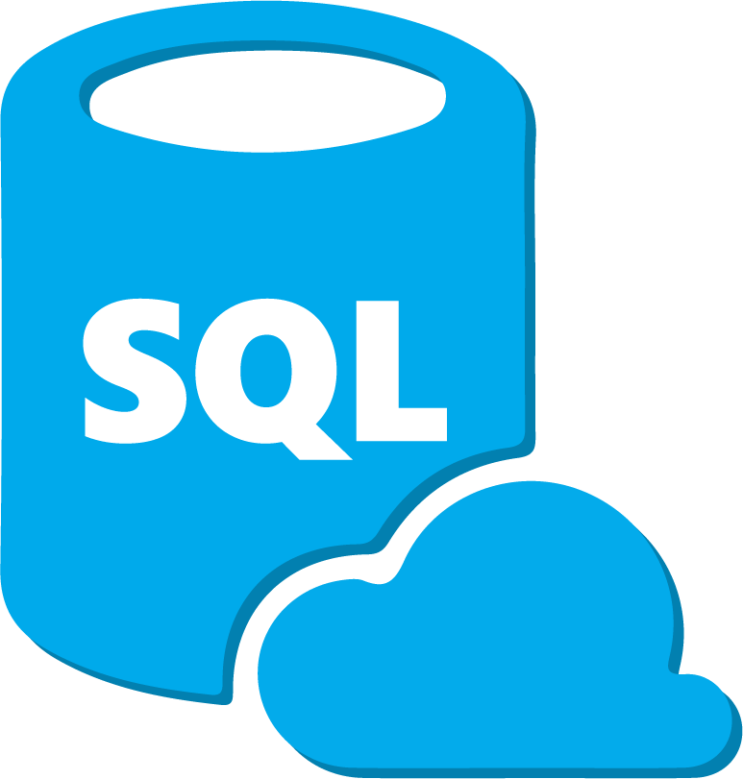
Azure Databricks SQL Deep Dive

Slide 6
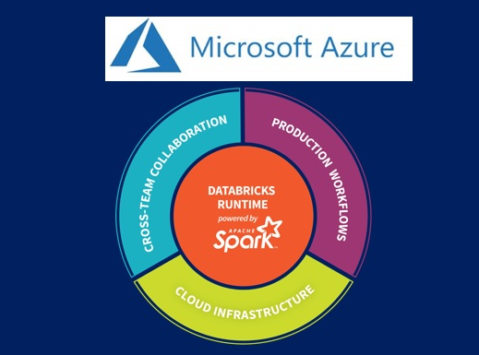
Azure Databricks SQL Deep Dive
Bryan Cafferky Technical Solutions Professional

